Slide 1
Positive Behaviour Supports
Recording

Slide 2

Taking a count
How many students in this class have freckles on their face?
How many students in this class do not have freckles on their face?

Slide 3
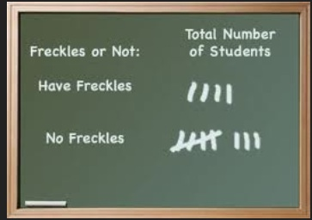
Taking a tally

Slide 4
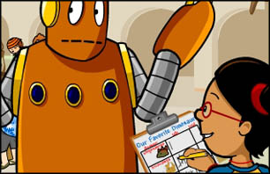
Frequency Recording
Define a behaviour
Count the number of times a discrete behaviour happens during an identified time period (class, day or event)
Make a tally for each occurrence
Counting ideas: moving items from one pocket to another, putting marks on tape stuck to wrist, use a golf counter, etc.

Slide 5
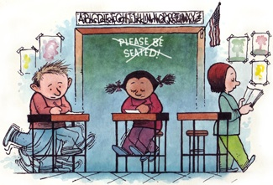
Frequency recording
Behaviour: leaving seat during science class

Slide 6
Frequency recording
Date | Time Start / stop | Occurrence of behaviour | Total Count
2/14/14 | 10:50 – 11:50 | IIII IIIII IIIII | 14
2/15/14 | 9:00-10:00 | IIIII IIIII IIIII IIIII | 20

Slide 7
Targeted behaviour: shouts out during class
Math IIIII II | Science III | Social 0 | Phys. Ed 0
Language Arts II | Home Room 0 | Lunch Room 0 | Library II

Slide 8
Targeted behaviour: swearing
1 ✓ | 2 ✓ | 3 ✓ | 4 ✓ | 5 ✓ | 6 ✓ | 7 ✓ | 8 | 9 | 10
1 ✓ | 2 ✓ | 3 ✓ | 4 ✓ | 5 ✓ | 6 | 7 | 8 | 9 | 10

Slide 9

Errors in recording observations
Errors of omission
Errors of commission
Errors of transmission

Slide 10
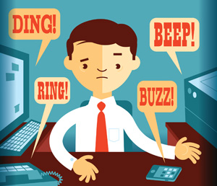
Omission
Leaving out information that is helpful or necessary
Important to include enough information to get a complete picture
Reasons for: distractions, missing action or poor note taking, recording after the fact rather than during

Slide 11

Transmission
Recording the behaviours you are observing in an improper sequence
Including correct information about time and activities

Slide 12

Commission
Include information than is actually present in the situation
Recording behaviours, people, speech or interactions that did not actually take place

Slide 13
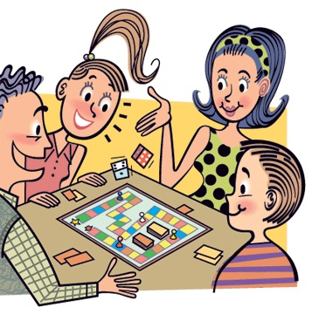
Activity
Develop an appropriate frequency recording form
Observe and record assigned behaviour in one game player
Observe and record assigned behaviours in one game player
Observe and record assigned behaviours in multiple game players

Slide 14

Activity
Develop an appropriate frequency recording form
Observe and record assigned behaviour in one game player
Observe and record assigned behaviours in one game player
Observe and record assigned behaviours in multiple game players

